Slide 1
Solutions Homework 1

Slide 2
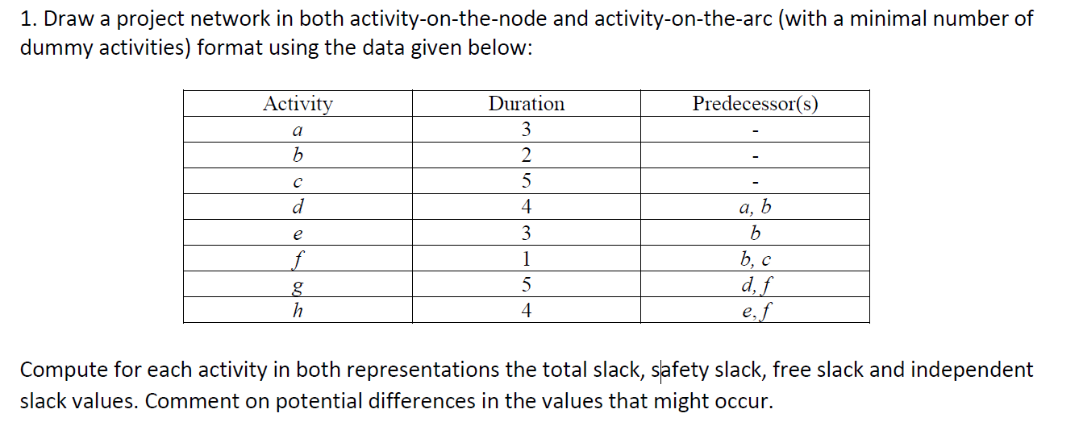
Question 1

Slide 3
Question 1: AoN representation
3
4
a
d
0/3
0/3
3/7
3/7
5
g
7/12
7/12
0
2
3
0
s
b
e
t
0/0
0/0
0/2
1/3
2/5
5/8
12/12
12/12
4
h
6/10
8/12
5
1
c
f
0/5
1/6
5/6
6/7

Slide 4
AoN: Time analysis
Act. | ES | EF | LS | LF | TS | FS | SS | IS
s | 0 | 0 | 0 | 0 | 0 | 0 | 0 | 0
a | 0 | 3 | 0 | 3 | 0 | 0 | 0 | 0
b | 0 | 2 | 1 | 3 | 1 | 0 | 1 | 0
c | 0 | 5 | 1 | 6 | 1 | 0 | 1 | 0
d | 3 | 7 | 3 | 7 | 0 | 0 | 0 | 0
e | 2 | 5 | 5 | 8 | 3 | 1 | 2 | 0
f | 5 | 6 | 6 | 7 | 1 | 0 | 0 | -1
g | 7 | 12 | 7 | 12 | 0 | 0 | 0 | 0
h | 6 | 10 | 8 | 12 | 2 | 2 | 0 | 0
t | 12 | 12 | 12 | 12 | 0 | 0 | 0 | 0
  IS_{i} = min {EST_{j} | j ϵ S_{i}} – max {LFT_{j} | j ϵ P_{i}} – d_{i}

Slide 5
AoA representation
3/3
2
d:4
a:3
7/7
6
g:5
8
2/3
1
b:2
3
12/12
e:3
h:4
0/0
c:5
7
5
6/8
f:1
4
6/7
5/6

Slide 6
AoA: Time analysis
Act. | ES | EF | LS | LF | TS | FS | SS | IS
a | 0 | 3 | 0 | 3 | 0 | 0 | 0 | 0
b | 0 | 2 | 1 | 3 | 1 | 0 | 1 | 0
c | 0 | 5 | 1 | 6 | 1 | 0 | 1 | 0
d | 3 | 7 | 3 | 7 | 0 | 0 | 0 | 0
e | 2 | 5 | 5 | 8 | 3 | 1 | 2 | 0
f | 5 | 6 | 6 | 7 | 1 | 0 | 0 | -1
g | 7 | 12 | 7 | 12 | 0 | 0 | 0 | 0
h | 6 | 10 | 8 | 12 | 2 | 2 | 0 | 0
Event | Early occurrence | Late occurrence | Event slack
1 | 0 | 0 | 0
2 | 3 | 3 | 0
3 | 2 | 3 | 1
4 | 5 | 6 | 1
5 | 6 | 7 | 1
6 | 7 | 7 | 0
7 | 6 | 8 | 2
8 | 12 | 12 | 0
  TS_{ij} = t_{j}(L) – t_{i}(E) – y_{ij} = t_{j}(L) – EFT_{ij} = LFT_{ij} - EFT_{ij}
  FS_{ij} = t_{j}(E) – t_{i}(E) – y_{ij} = t_{j}(E) – EFT_{ij}
  SS_{ij} = t_{j}(L) – t_{i}(L) – y_{ij} = LST_{ij} – t_{i}(L)
  IS_{ij} = t_{j}(E) – t_{i}(L) – y_{ij}

Slide 7
Typical mistakes
Independent slack for activity f = 0
-1, can be negative!
Too many dummy arcs for the AoA network: 4 dummy arcs are sufficient!
Representation indirectly implies e before g or doesn’t show f before g

Slide 8
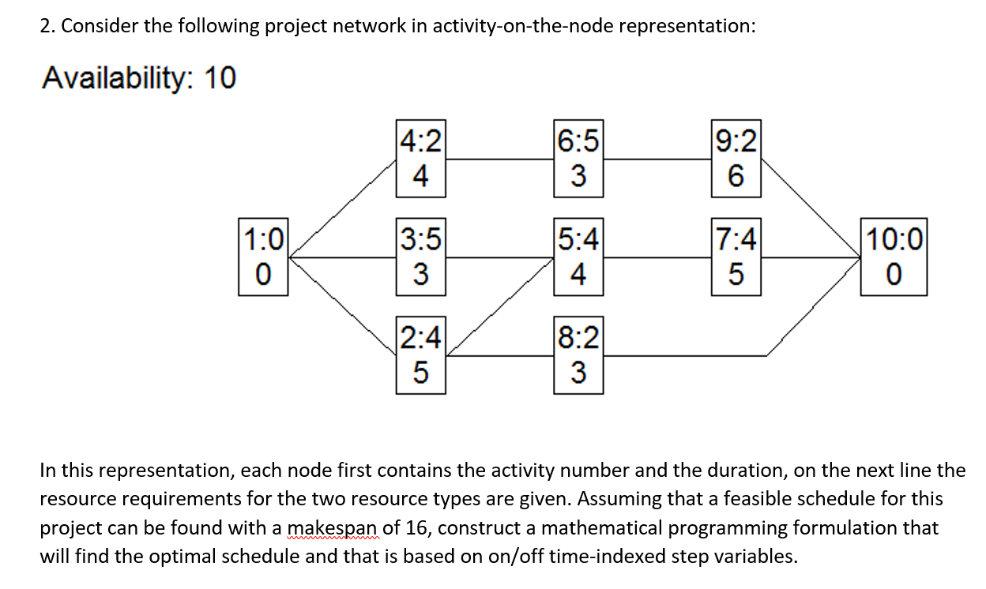
Question 2

Slide 9
Question 2
1
2
3
4
5
6
7
8
9
10
11
12
13
14
15
16
17
Time

Slide 10
ILP model
Minimize 15 x_{10,15} + 16 x_{10,16} + 17 x_{10,17}
ST:
x₁₁ (+ x₁₂ + x₁₃) = 1
x₂₂ + x₂₃ + x₂₄ + x₂₅ + x₂₆ + x₂₇ + x₂₈ = 4
x₃₂ + x₃₃ + x₃₄ + x₃₅ + x₃₆ + x₃₇ + x₃₈ = 5
x₄₂ + x₄₃ + x₄₄ + x₄₅ + x₄₆ + x₄₇ + x₄₈ + x₄₉ = 2
x₅₇ + x₅₈ + x₅₉ + x_{5,10} + x_{5,11} + x_{5,12} = 4
x₆₄ + x₆₅ + x₆₆ + x₆₇ + x₆₈ + x₆₉ + x_{6,10} + x_{6,11} + x_{6,12} + x_{6,13} + x_{6,14} = 5
x_{7,11} + x_{7,12} + x_{7,13} + x_{7,14} + x_{7,15} + x_{7,16} = 4
x₈₆ + x₈₇ + x₈₈ + x₈₉ + x_{8,10} + x_{8,11} + x_{8,12} + x_{8,13} + x_{8,14} + x_{8,15} + x_{8,16} = 2
x₉₉ + x_{9,10} + x_{9,11} + x_{9,12} + x_{9,13} + x_{9,14} + x_{9,15} + x_{9,16} = 2
X_{10,15} + x_{10,16} + x_{10,17} = 1

Slide 11
ILP model
For activity 2:
4 (x₂₂ - x₂₃) <= 1
4 (x₂₃ - x₂₄) - x₂₂ <= 1
4 (x₂₄ - x₂₅) - x₂₂ - x₂₃ <= 1
4 (x₂₅ - x₂₆) - x₂₂ - x₂₃ - x₂₄ <= 1
4 (x₂₆ - x₂₇) - x₂₃ - x₂₄ - x₂₅ <= 1
4 (x₂₇ - x₂₈) - x₂₄ - x₂₅ - x₂₆ <= 1
Similar constraints for other activities

Slide 12
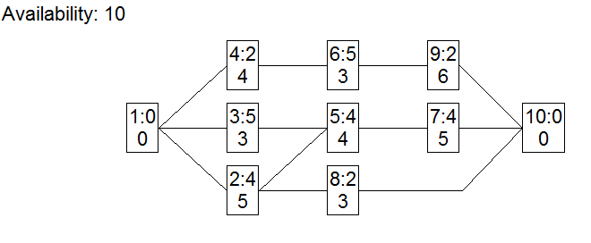
ILP model
For precedence relation (3,5):
x₅₇ <= x₃₂
x₅₈ <= x₃₃
x₅₉ <= x₃₄
For precedence relation (4,6):
x₆₄ <= x₄₂
x₆₅ <= x₄₃
x₆₆ <= x₄₃ + x₄₄
x₆₇ <= x₄₃ + x₄₄ + x₄₅
x₆₈ <= x₄₃ + x₄₄ + x₄₅ + x₄₆
x₆₉ <= x₄₃ + x₄₄ + x₄₅ + x₄₆ + x₄₇
Similar constraints for other precedence relations

Slide 13
ILP model
5 x₂₂ + 3 x₃₂ + 4 x₄₂ <= 10
5 x₂₃ + 3 x₃₃ + 4 x₄₃ <= 10
5 x₂₄ + 3 x₃₄ + 4 x₄₄ + 3 x₆₄ <= 10
5 x₂₅ + 3 x₃₅ + 4 x₄₅ + 3 x₆₅ <= 10
5 x₂₆ + 3 x₃₆ + 4 x₄₆ + 3 x₆₆ + 3 x₈₆ <= 10
5 x₂₇ + 3 x₃₇ + 4 x₄₇ + 4 x₅₇ + 3 x₆₇ + 3 x₈₇ <= 10
5 x₂₈ + 3 x₃₈ + 4 x₄₈ + 4 x₅₈ + 3 x₆₈ + 3 x₈₈ + 6 x₉₈ <= 10
4 x₄₉ + 4 x₅₉ + 3 x₆₉ + 3 x₈₉ + 6 x₉₉ <= 10
4 x_{5,10} + 3 x_{6,10} + 3 x_{8,10} + 6 x_{9,10} <= 10
4 x_{5,11} + 3 x_{6,11} + 5 x_{7,11} + 3 x_{8,11} + 6 x_{9,11} <= 10
4 x_{5,12} + 3 x_{6,12} + 5 x_{7,12} + 3 x_{8,12} + 6 x_{9,12} <= 10
3 x_{6,13} + 5 x_{7,13} + 3 x_{8,13} + 6 x_{9,13} <= 10
3 x_{6,14} + 5 x_{7,14} + 3 x_{8,14} + 6 x_{9,14} <= 10
5 x_{7,15} + 3 x_{8,15} + 6 x_{9,15} <= 10
5 x_{7,16} + 3 x_{8,16} + 6 x_{9,16} <= 10
1
2
3
4
5
6
7
8
9
10
11
12
13
14
15
16
17
Time

Slide 14
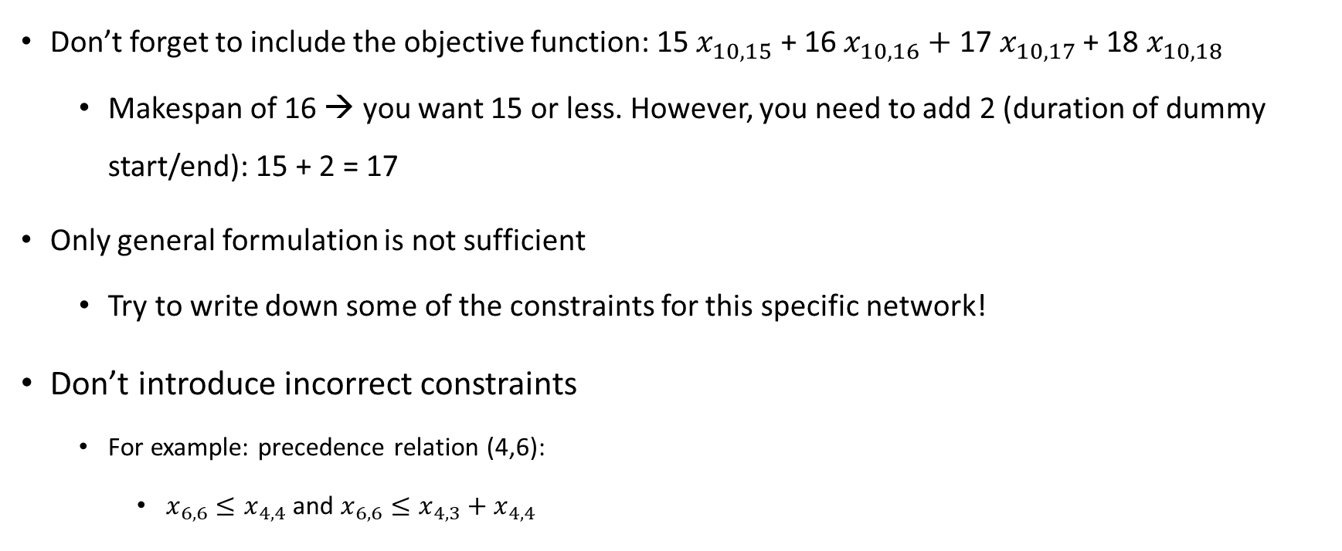
Typical mistakes
Don’t forget to include the objective function: 15 $x_{10,15}$ + 16 $x_{10,16}+\text{17 }x_{10,17}$ + 18 $x_{10,18}$
  Makespan of 16 → you want 15 or less. However, you need to add 2 (duration of dummy start/end): 15 + 2 = 17
Only general formulation is not sufficient
  Try to write down some of the constraints for this specific network!
Don’t introduce incorrect constraints
  For example: precedence relation (4,6):
    $x_{6,6}≤x_{4,4}$and $x_{6,6}≤x_{4,3}+x_{4,4}$

Slide 15
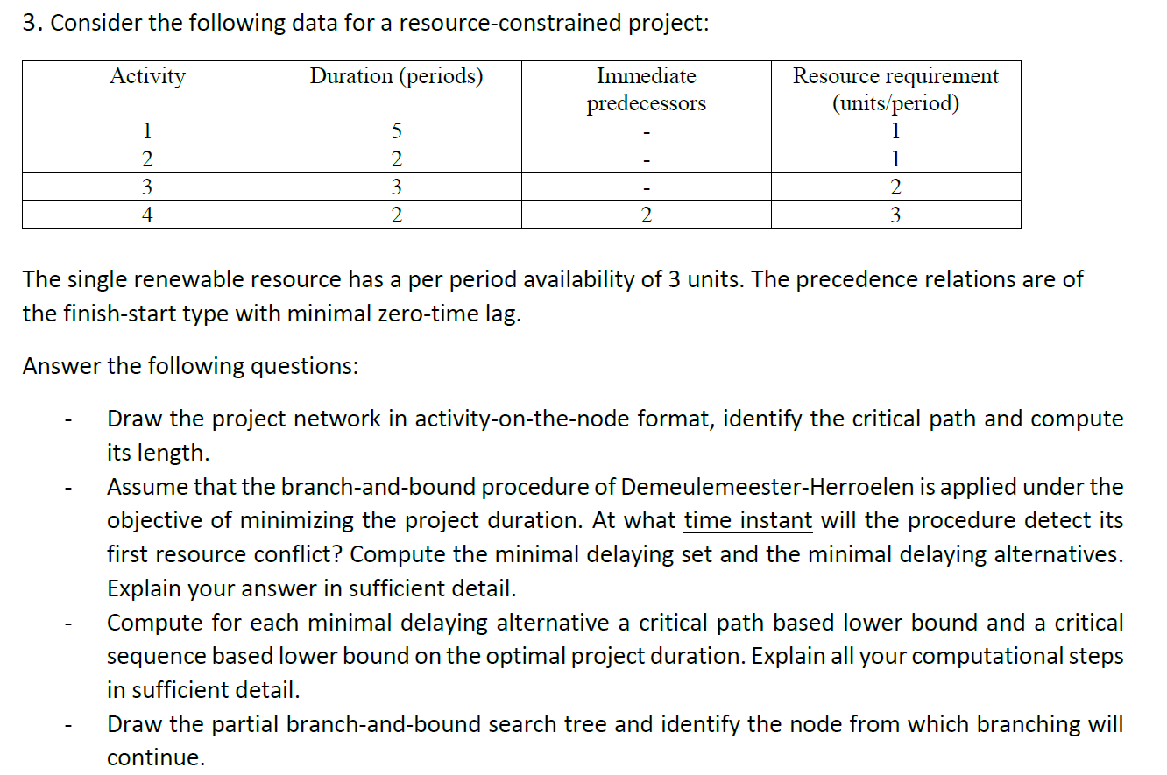
Question 3

Slide 16
Question 3
1:5
1
0:0
0
2:2
1
4:2
3
5:0
0
CP = 0-1-5 with a length of 5
At time 0, activities 1, 2 and 3 can be started with a resource requirement of 4, which is beyond the availability of 3
D = {{1}, {2}, {3}}
Delaying alternatives:
  2 <. 1
  3 <. 2
  2 <. 3
3:3
2

Slide 17
Question 3
4:3
2:1
1:1
2 <. 1: CPLB = 2 + 5 = 7
CSLB = max (7 + 2 – 0) = 9
3 <. 2: CPLB = 3 + 4 = 7
CSLB = max (7) = 7
2 <. 3: CPLB = 2 + 3 = 5
CSLB = max (5 + 2 – 0) = 7
CSLB = max (5 + 3 – 3;
5 + 2 – 0) = 7
3:2
2:1
4:3
4:3
4:3
3:2
2:1
3:2
1:1

Slide 18
Question 3
Root node
CPLB = 5
(CSLB = 7)
2 <. 3
CPLB = 5
CSLB = 7
3 <. 2
CPLB = 7
CSLB = 7
2 <. 1
CPLB = 7
CSLB = 9

Slide 19
Typical mistakes
Renumbering the activities
Calculating the critical sequence lower bound only for one delaying alternative
Calculating the critical sequence lower bound and not using it in the branch-and-bound tree

Slide 20
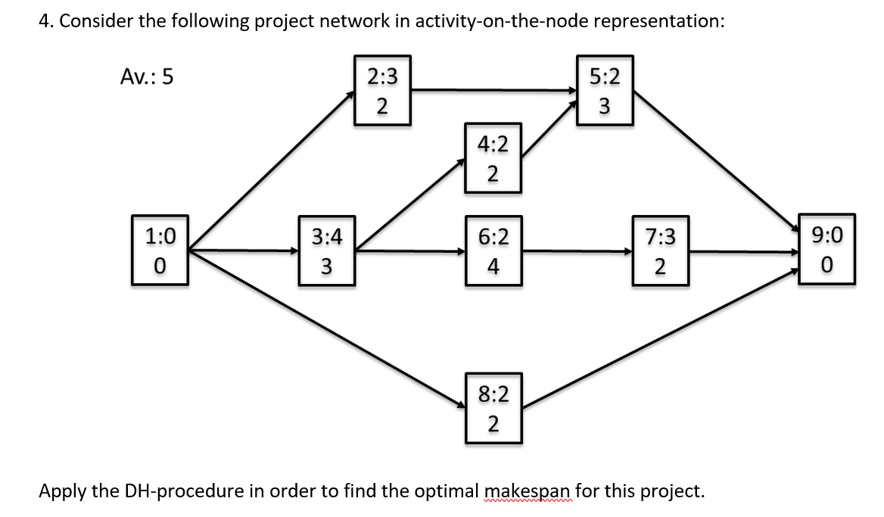
Question 4

Slide 21
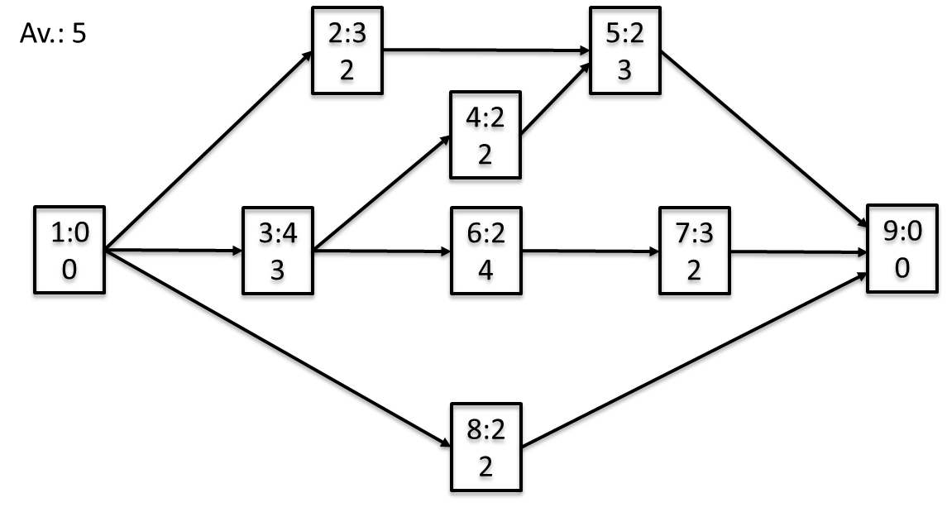
Question 4
LB = 10
2 <. 8
LB = 10
8 <. 2
LB = 10
8 <. 3
LB = 12
6 <. 4,8
LB = 10
8 <. 6
LB = 10
6 <. 2,4
LB = 11
2 <. 6
LB = 10
4 <. 8
LB = 10
4 <. 7
LB = 11
8 <. 4
LB = 12
6 <. 4
LB = 11
4 <. 6
LB = 11
7 <. 8
LB = 11
7 <. 5
LB = 11
5 <. 7
LB = 13

Slide 22
Question 4
Step 1: T = 9999; p = m = 0; critical path lb = 9 (path 1-3-6-7-9);
critical sequence lb = 10 (act. 4 can only be scheduled for 1 period in parallel with act. 7); PS = S = {1}; t₁ = 0; C = {2,3,8}
Step 2: m = 0; S = {}; cutset not dominated; E = {2,3,8}
Step 3: theorems 3 and 4 are not applicable
Step 4: PS = {1,2,3,8}; S = {2,3,8}; t₂ = 3; t₃ = 4; t₈ = 2; C = {4,6};
2 + 3 + 2 = 7 > 5 → resource conflict
Step 5: p = 1; D(1) = {{2},{3},{8}}
  D₁ = {2}, G₁ ={(8,2)}, L₁ = 9/10
  D₂ = {3}, G₂ ={(8,3)}, L₂ = 11/12
  D₃ = {8}, G₃ ={(2,8)}, L₃ = 9/10
  Select D₃; D(1) = {{2},{3}}

Slide 23
Question 4
Step 6: DS={}; H = H + {(2,8)}; t₈ = 9999; PS = {1,2,3};
S = {2,3}; C = {4,6,8}
Step 2: m = 3; S = {3}; C = {4,6,8}; cutset not dominated; E = {8}
Step 4: PS = {1,2,3,8}; S = {3,8}; t₈ = 5; C = {4,6};
3 + 2= 5 <= 5 → no resource conflict
Step 2: m = 4; S = {8}; C = {4,6}; cutset not dominated; E = {4,6}
Step 4: PS = {1,2,3,4,6,8}; S = {4,6,8}; t₄ = t₆ = 6; C = {5,7};
2 + 4 + 2 = 8 > 5 → resource conflict
Step 5: p = 2; D(2) = {{6},{4,8}}
  D₁ = {6}, G₁ ={(8,6)}, L₁ = 10
  D₂ = {4,8}, G₂ ={(6,4),(6,8)}, L₃ = 10
  Select D₂; D(2) = {{6}}

Slide 24
Question 4
Step 6: DS={}; H = H + {(6,4),(6,8)}; t₄ = t₈ = 9999; PS = {1,2,3,6}; S = {6}; C = {4,7,8}
Step 2: m = 6; S = {}; C = {4,7,8}; cutset not dominated; E = {4,7,8}
Step 4: PS = {1,2,3,4,6,7,8}; S = {4,7,8}; t₇ = 9; t₄ = t₈ = 8; C = {5}; 2 + 2 + 2 = 6 > 5 → resource conflict
Step 5: p = 3; D(3) = {{4},{7},{8}}
  D₁ = {4}, G₁ ={(8,4)}, L₁ = 12
  D₂ = {7}, G₂ ={(4,7)}, L₂ = 11
  D₃ = {8}, G₃ ={(4,8)}, L₃ = 10
  Select D₃; D(3) = {{4},{7}}
Step 2: m = 8; S = {7}; C = {5,8}; cutset not dominated; E = {5,8}
Step 4: PS = {1,2,3,4,5,6,7,8}; S = {5,7,8}; t₅ = t₈ = 10; C = {9};
3 + 2 + 2 = 7 > 5 → resource conflict
Step 5: p = 4; D(4) = {{5},{7},{8}}
  D₁ = {5}, G₁ ={(7,5)}, L₁ = 11
  D₂ = {7}, G₂ ={(5,7)}, L₂ = 13
  D₃ = {8}, G₃ ={(7,8)}, L₃ = 11
  Select D₃; D(4) = {{5}, {7}}

Slide 25
Question 4
Step 6: DS={}; H = H + {(7,8)}; t₈ = 9999; PS = {1,2,3,4,5,6,7}; S = {5,7}; C = {8}
Step 2: m = 9; S = {5}; C = {8}; cutset not dominated; E = {8}
Step 4: PS = {1,2,3,4,5,6,7,8}; S = {5,8}; C = {9};
3 + 2 = 5 <= 5 → no resource conflict
Step 2: m = 10; S = {8}; C = {9}; cutset not dominated; E = {}
Step 4: PS = {1,2,3,4,5,6,7,8}; S = {8}; C = {9};
2 <= 5 → no resource conflict
Step 2: m = 11; S = {}; C = {9}; cutset not dominated; E = {9};
Step 3: Act. 9 can only be scheduled by itself: PS = {1,2,3,4,5,6,7,8,9};
S = {9}; t₉ = 11; The dummy end activity is finished, thus the schedule is complete with a length of 11.

Slide 26
Question 4
Step 7: Remove the extra delaying constraint (7,8): the delaying alternatives
{5} or {7} needn’t be considered as the lower bound is larger than or equal to 11.
Step 7: Remove the extra delaying constraint (4,8): the other delaying alternatives at this level needn’t be considered as the lower bounds are larger than or equal to 11.
Step 7: Remove the extra delaying constraints (6,4) and (6,8): select delaying alternative {6} as it has a lower bound of 10.
Step 6: DS={}; H = H + {(8,6)}; t₆ = 9999; PS = {1,2,3,4,8}; S = {4,8}; C = {5,6}
Step 2: m = 5; S = {4}; C = {5,6}; cutset not dominated; E = {6}
Step 4: PS = {1,2,3,4,6,8}; S = {4,6}; t₆ = 7; C = {5,7};
2 + 4 = 6 > 5 → resource conflict
Step 5: p = 3; D(3) = {{4},{6}}
  D₁ = {4}, G₁ ={(6,4)}, L₁ = 11
  D₂ = {6}, G₂ ={(4,6)}, L₂ = 11
  No minimal delaying alternative has a lower bound that is smaller than the current upper bound: backtrack to the previous level

Slide 27
Question 4
Step 7: Remove the extra delaying constraints (8,6): no delaying
alternative is left at this level: backtrack to the previous level.
Step 7: Remove the extra delaying constraints (2,8): select delaying
alternative {2} as it has a lower bound of 10.
Step 6: DS={}; H = H + {(8,2)}; t₂ = 9999; PS = {1,3,8}; S = {3,8}; C = {2,4,6}
Step 2: m = 2; S = {3}; C = {2,4,6}; cutset not dominated; E = {2}
Step 4: PS = {1,2,3,8}; S = {2,3}; t₂ = 5; C = {4,6}; 2 + 3 = 5 <= 5 → no resource conflict
Step 2: m = 4; S = {2}; C = {4,6}; cutset not dominated; E = {4,6}
Step 4: PS = {1,2,3,4,6,8}; S = {2,4,6}; t₄ = t₆ = 6; C = {5,7};
2 + 2 + 4 = 8 > 5 → resource conflict
Step 5: p = 2; D(2) = {{2,4},{6}}
  D₁ = {2,4}, G₁ ={(6,2),(6,4)}, L₁ = 11
  D₂ = {6}, G₂ ={(2,6)}, L₂ = 10
  Select D₂; D(2) = {{2,4}}

Slide 28
Question 4
Step 6: DS={}; H = H + {(2,6)}; t₆ = 9999; PS = {1,2,3,4,8}; S = {2,4}; C = {5,6}
Step 2: m = 5; S = {4}; C = {5,6}; cutset is dominated → Backtrack
Step 7: Remove the extra delaying constraint (2,6): the remaining delaying alternative at this level needn’t be considered as the lower bound is equal to 11.
Step 7: Remove the extra delaying constraint (8,2): the remaining delaying alternative at this level needn’t be considered as the lower bound is larger than 11.
8
2
is dominated by:
2
8
3
3
4
4

Slide 29
Typical mistakes
You need to backtrack to the first level of the tree and branch on the delaying alternative 2<.8 or 8<.2. The LB of these alternatives is 10 and possibly a better solution can be found by branching from this node
Only a few groups calculated the critical sequence LB. However, there is an advantage in doing so as this bound is sometimes stronger than the critical path based LB
You should only consider minimal delaying alternatives

