Slide 1
Solutions Homework 2

Slide 2
Exercise 1
Maximal resource requirements: 5/6/6
5/-/-: no
6/-/-: no
7/-/-: yes
  -/6/-: no
  -/7/-: no
  -/8/-: yes
    -/-/6: no
    -/-/7: no
    -/-/8: yes

Slide 3
Exercise 1
7/8/-: no
7/9/-: no
7/10/-: yes
  8/9/-: yes
  8/8/-: no
    9/8/-: no
    10/8/-: yes
PES2:
  7/10
  8/9
  10/8
7/-/8: no
7/-/9: no
7/-/10: yes
  8/-/9: yes
  8/-/8: yes
PES3:
  7/10
  8/8
EP = {7,8,10}

Slide 4
Exercise 1
7/10/10 (148)
8/9/8 (133)
10/8/8 (136)
Sorting:
  8/9/8 (133)
  10/8/8 (136)
  7/10/10 (148)
8/9/8: yes (makespan of 39)

Slide 5
Exercise 2: Early tree
2
2
-50
1
5
100
4
8
100
0
1
0
5
3
-150
3
6
50
0
10
0
1
9
200
3
4
-100
2
7
50

Slide 6
Exercise 2: Current tree
2
2
-50
1
5
100
4
8
100
0
1
0
5
3
-150
3
6
50
0
10
0
1
9
200
3
4
-100
2
7
50
DC(4,7) = -47,131
Remove arc (1,4)
Introduce arc (4,6)
DC(4) = -86,071
DC(7) = 38,940

Slide 7
Exercise 2: Recursion – delay {4,7}
2
2
-50
1
5
100
4
8
100
0
1
0
5
3
-150
3
6
50
0
10
0
1
9
200
3
4
-100
2
7
50
DC = 91,599

Slide 8
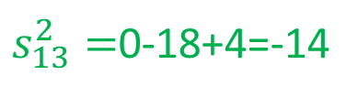
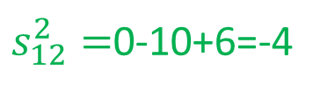
Exercise 3
(9,4,5)
2
4
(10,6,4)
10
19
(5,1,3)
(8,3,2)
1
5
0
(6,2,6)
24
(12,4,7)
3
Legend: (u_{ij},l_{ij},a_{ij})
18
$s_{12}^{2}=$0-10+6=-4
$s_{13}^{2}=$0-18+4=-14
Non-breakthrough

Slide 9
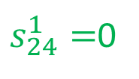
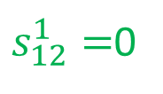
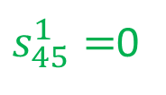
Exercise 3
(4,1)
(4,2)
(9,4:5-0)
2
4
(10,6:4-0)
10
19
(5,1:3-0)
(8,3:2-0)
(∞,0)
(3,4)
1
5
0
(6,2:6-0)
24
(12,4:7-0)
3
18
$s_{12}^{1}=$0
Breakthrough of 3
$s_{24}^{1}=$0
$s_{45}^{1}=$0

Slide 10
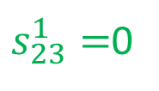
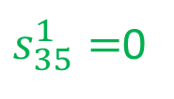
Exercise 3
(1,1)
(9,4:2-3)
2
4
(10,6:1-3)
10
19
(5,1:0-3)
(8,3:2-0)
(∞,0)
(1,3)
1
5
0
(6,2:6-0)
24
(12,4:7-0)
(1,2)
3
18
$s_{12}^{1}=$0
Breakthrough of 1
$s_{23}^{1}=$0
$s_{35}^{1}=$0

Slide 11
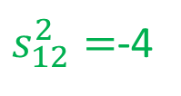
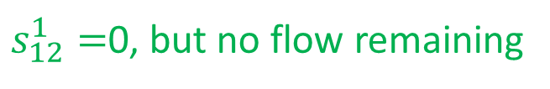
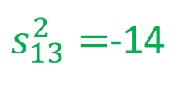
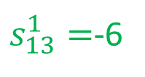
Exercise 3
(9,4:2-3)
2
4
(10,6:0-4)
10
19
(5,1:0-3)
(8,3:1-1)
(∞,0)
1
5
0
(6,2:5-1)
24
(12,4:7-0)
3
18
$s_{12}^{1}=$0, but no flow remaining
Non-breakthrough
$s_{12}^{2}=$-4
$s_{13}^{1}=$-6
$s_{13}^{2}=$-14

Slide 12
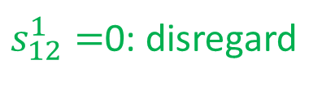
Exercise 3
(9,4:2-3)
2
4
(10,6:0-4)
10
19
(5,1:0-3)
(8,3:1-1)
(∞,0)
1
5
0
(6,2:5-1)
24
(12,4:7-0)
3
18
$s_{12}^{1}=$0: disregard
Min (4,6,14) = 4
Update nodes 2, 3, 4 and 5
$s_{12}^{2}=$-4
$s_{13}^{1}=$-6
$s_{13}^{2}=$-14

Slide 13
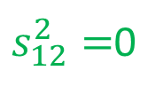
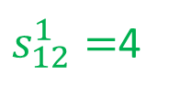
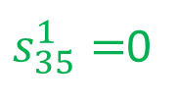

Exercise 3
(∞,1)
(9,4:2-3)
2
4
(10,6:0-4)
6
15
(5,1:0-3)
(8,3:1-1)
(∞,0)
(∞-0)
(1,3)
1
5
0
(6,2:5-1)
20
(12,4:7-0)
(1,2)
3
14
$s_{12}^{1}=$4
Breakthrough of 1
$s_{12}^{2}=$0
$s_{23}^{1}=$0
$s_{35}^{1}=$0

Slide 14
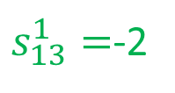
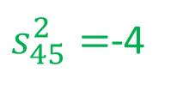
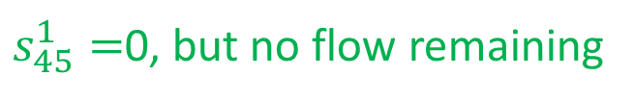
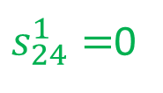
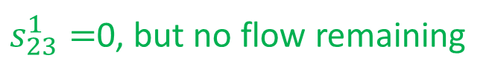
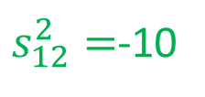
Exercise 3
(∞,1)
(2,2)
(9,4:2-3)
2
4
(10,6:0-4)
6
15
(5,1:0-3)
(8,3:0-2)
(∞,0)
(∞-1)
1
5
0
(6,2:4-2)
20
(12,4:7-0)
3
$s_{45}^{1}=$0, but no flow remaining
14
$s_{12}^{1}=$4
$s_{45}^{2}=$-4
$s_{12}^{2}=$0
$s_{13}^{1}=$-2
Non-breakthrough
$s_{23}^{1}=$0, but no flow remaining
$s_{12}^{2}=$-10
$s_{24}^{1}=$0

Slide 15

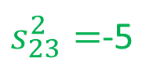

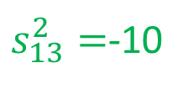
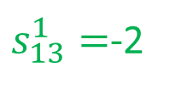
Exercise 3
(∞,1)
(2,2)
(9,4:2-3)
2
4
(10,6:0-4)
6
15
(5,1:0-3)
(8,3:0-2)
(∞,0)
(∞-1)
1
5
0
(6,2:4-2)
20
(12,4:7-0)
3
$s_{13}^{1}=$-2
$s_{45}^{1}=$0: disregard
14
$s_{13}^{2}=$-10
$s_{45}^{2}=$-4
$s_{23}^{1}=$0: disregard
Min (2,10,5,4) = 2
Update nodes 3 and 5
$s_{23}^{2}=$-5

Slide 16



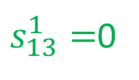

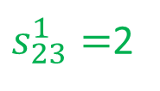
Exercise 3
(∞,1)
(2,2)
(9,4:2-3)
2
4
(10,6:0-4)
6
15
(5,1:0-3)
(8,3:0-2)
(∞,0)
(∞-1)
(4,3)
1
5
0
(6,2:4-2)
18
(12,4:7-0)
(7,1)
3
$s_{12}^{1}=$4
$s_{13}^{1}=$0
12
$s_{12}^{2}=$0
$s_{35}^{1}=$0
$s_{23}^{1}=$2
Breakthrough of 4
$s_{24}^{1}=$0

Slide 17
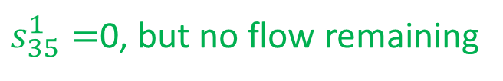
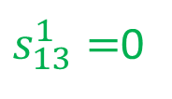
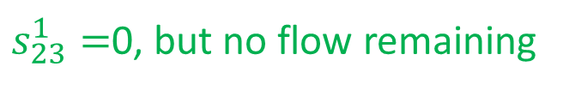
Exercise 3
(∞,1)
(2,2)
(9,4:2-3)
2
4
(10,6:0-4)
6
15
(5,1:0-3)
(8,3:0-2)
(∞,0)
(∞-1)
1
5
0
(6,2:0-6)
18
(12,4:3-4)
(3,1)
3
$s_{12}^{1}=$4
$s_{13}^{1}=$0
12
$s_{12}^{2}=$0
$s_{35}^{1}=$0, but no flow remaining
$s_{23}^{1}=$0, but no flow remaining
Non-breakthrough
$s_{24}^{1}=$0

Slide 18
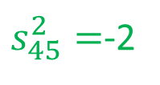
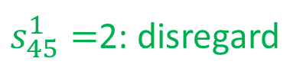
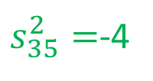

Exercise 3
(∞,1)
(2,2)
(9,4:2-3)
2
4
(10,6:0-4)
6
15
(5,1:0-3)
(8,3:0-2)
(∞,0)
(∞-1)
1
5
0
(6,2:0-6)
18
(12,4:3-4)
(3,1)
3
$s_{45}^{1}=$2: disregard
12
$s_{45}^{2}=$-2
$s_{35}^{1}=$0: disregard
Min (2,4) = 2
Update node 5
$s_{35}^{2}=$-4

Slide 19
Exercise 3
(∞,1)
(2,2)
(9,4:2-3)
2
4
(10,6:0-4)
6
15
(5,1:0-3)
(8,3:0-2)
(∞,0)
(∞-1)
1
5
0
(6,2:0-6)
16
(12,4:3-4)
(3,1)
3
12
Increase in cost = 4 * 4 + 2 * 5 + 2 * 9 = 44
Or act.1-2: 4 * 4 = 16, act. 2-3: 2 * 2 = 4, act. 3-5: 2 * 6 = 12, and
act. 4-5: 4 * 3 = 12: total = 16 + 4 + 12 +12 = 44

