Slide 1
Solutions Homework 2

Slide 2
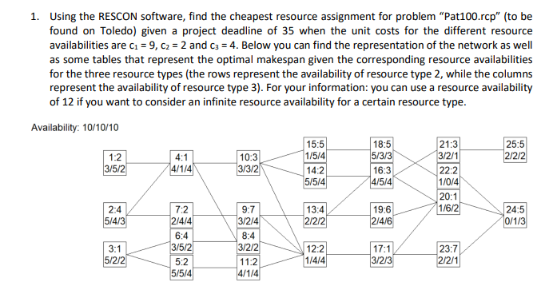
Question 1

Slide 3
Question 1
Maximal resource requirements: 5/6/6
5/-/-: no
6/-/-: no
7/-/-: no
8/-/-: yes
  -/6/-: no
  -/7/-: no
  -/8/-: no
  -/9/-: yes
    -/-/6: no
    -/-/7: no
    -/-/8: no
    -/-/9: yes
At least 8/9/9 is required

Slide 4
Question 1
8/9/-: no
8/10/-: no
8/11/-: yes
  9/10/-: yes
  9/9/-: yes
PES2:
  8/11
  9/9
8/-/9: no
8/-/10: no
8/-/11: yes
  9/-/10: yes
  9/-/9: no
    10/-/9: no
    11/-/9: no
    12/-/9: yes
PES3:
  8/11
  9/10
  12/9
EP = {8,9,12}

Slide 5
Question 1
Sorted combinations:
  8/11/11 (138)
  9/9/10 (139)
  12/9/9 (162)
Consider in order:
  8/11/11 (138): yes → optimal solution

Slide 6
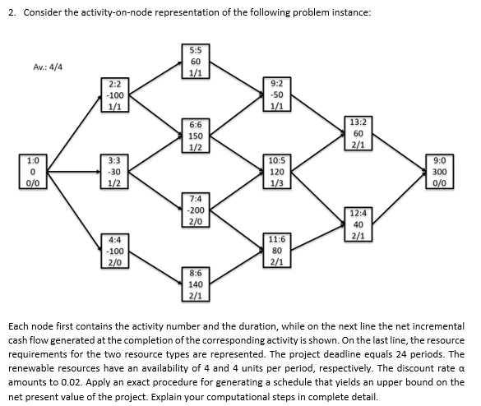
Question 2
14

Slide 7
Question 2: Early tree
NPV = 281,70
5:5
60
1/1
2:2
-100
1/1
9:2
-50
1/1
6:6
150
1/2
13:2
60
2/1
1:0
0
0/0
3:3
-30
1/2
10:5
120
1/3
14:0
300
0/0
15:0
0
0/0
7:4
-200
2/0
12:4
40
2/1
4:4
-100
2/0
11:6
80
2/1
8:6
140
2/1

Slide 8
Question 2: Current tree
NPV = 290,85
5:5
60
1/1
2:2
-100
1/1
9:2
-50
1/1
6:6
150
1/2
13:2
60
2/1
1:0
0
0/0
3:3
-30
1/2
10:5
120
1/3
14:0
300
0/0
15:0
0
0/0
7:4
-200
2/0
12:4
40
2/1
4:4
-100
2/0
11:6
80
2/1
8:6
140
2/1

Slide 9
Question 2: Recursion
5:5
60
1/1
DC = -96,08 + 52,16 = -43,92
2:2
-100
1/1
9:2
-50
1/1
6:6
150
1/2
13:2
60
2/1
1:0
0
0/0
3:3
-30
1/2
10:5
120
1/3
14:0
300
0/0
15:0
0
0/0
7:4
-200
2/0
12:4
40
2/1
4:4
-100
2/0
11:6
80
2/1
8:6
140
2/1

Slide 10
Question 2: Recursion
NPV = 291,72
5:5
60
1/1
2:2
-100
1/1
9:2
-50
1/1
6:6
150
1/2
13:2
60
2/1
1:0
0
0/0
3:3
-30
1/2
10:5
120
1/3
14:0
300
0/0
15:0
0
0/0
7:4
-200
2/0
12:4
40
2/1
4:4
-100
2/0
11:6
80
2/1
8:6
140
2/1

Slide 11
Question 2: Recursion
5:5
60
1/1
2:2
-100
1/1
9:2
-50
1/1
DC = -167,05 - 37,79
+ 90,69 + 43,57 = -70,58
6:6
150
1/2
13:2
60
2/1
1:0
0
0/0
3:3
-30
1/2
10:5
120
1/3
14:0
300
0/0
15:0
0
0/0
7:4
-200
2/0
12:4
40
2/1
4:4
-100
2/0
11:6
80
2/1
8:6
140
2/1

Slide 12
Question 2: Recursion
DC = 293,12
5:5
60
1/1
2:2
-100
1/1
9:2
-50
1/1
6:6
150
1/2
13:2
60
2/1
1:0
0
0/0
3:3
-30
1/2
10:5
120
1/3
14:0
300
0/0
15:0
0
0/0
7:4
-200
2/0
12:4
40
2/1
4:4
-100
2/0
11:6
80
2/1
8:6
140
2/1

Slide 13
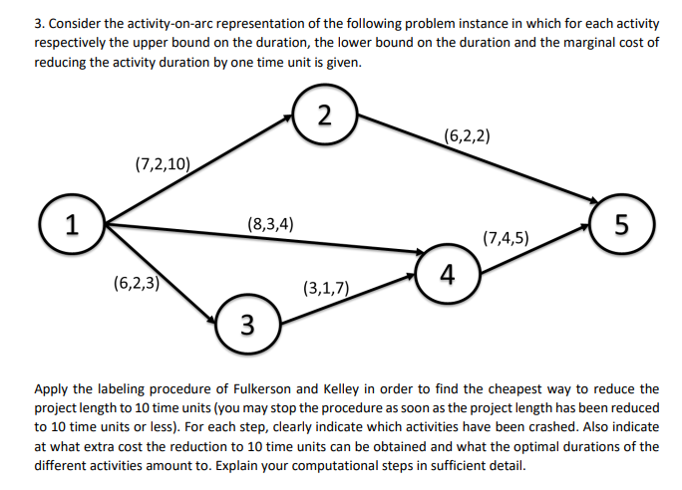
Question 3

Slide 14
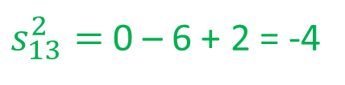
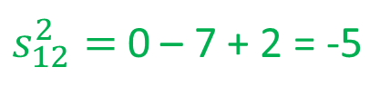
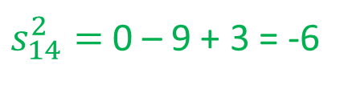
Question 3
$s_{12}^{2}=$0 – 7 + 2 = -5
$s_{13}^{2}=$ 0 – 6 + 2 = -4
$s_{14}^{2}=$ 0 – 9 + 3 = -6
2
Non-breakthrough
(6,2,2,0)
7
(7,2,10,0)
1
5
(8,3,4,0)
(7,4,5,0)
0
4
16
(6,2,3,0)
(3,1,7,0)
3
9
Legend: (u_{ij},l_{ij},r_{ij},f_{ij})
6

Slide 15
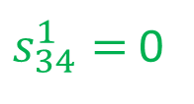
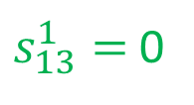
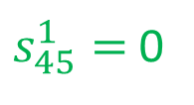
Question 3
$s_{13}^{1}=$ 0
Breakthrough of 3
$s_{34}^{1}=$0
$s_{45}^{1}=$ 0
2
(6,2,2,0)
7
(∞,0)
(7,2,10,0)
(3,4)
1
5
(8,3,4,0)
(3,3)
(7,4,5,0)
0
4
16
(3,1)
(3,1,7,0)
(6,2,3,0)
3
9
Legend: (u_{ij},l_{ij},r_{ij},f_{ij})
6

Slide 16
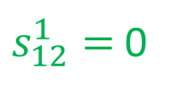
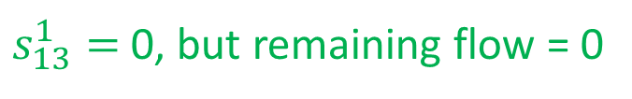
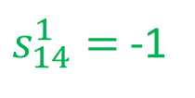
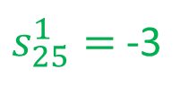
Question 3
$s_{13}^{1}=$ 0, but remaining flow = 0
$s_{12}^{1}=$ 0
(10,1)
$s_{25}^{1}=$ -3
2
$s_{14}^{1}=$ -1
Non-breakthrough
(6,2,2,0)
7
(∞,0)
(7,2,10,0)
1
5
(8,3,4,0)
(7,4,2,3)
0
4
16
(6,2,0,3)
(3,1,4,3)
3
9
Legend: (u_{ij},l_{ij},r_{ij},f_{ij})
6

Slide 17







Question 3
$s_{13}^{1}=$ 0: disregard
$$\min\left(4,1,6,3,7\right)=1$$
$s_{13}^{2}=$ -4
$s_{14}^{1}=$ -1
(10,1)
$s_{14}^{2}=$-6
2
$s_{25}^{1}=$-3
(6,2,2,0)
$s_{25}^{2}=$-7
7
(∞,0)
(7,2,10,0)
1
5
(8,3,4,0)
(7,4,2,3)
0
4
16
(6,2,0,3)
(3,1,4,3)
15
3
9
8
Legend: (u_{ij},l_{ij},r_{ij},f_{ij})
6
5

Slide 18
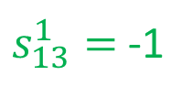

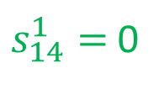
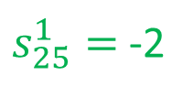
Question 3
$s_{13}^{1}=$-1
Breakthrough of 2
$s_{12}^{1}=$ 0
(10,1)
$s_{25}^{1}=$ -2
2
$s_{14}^{1}=$0
$s_{45}^{1}=$0
(6,2,2,0)
7
(∞,0)
(7,2,10,0)
(2,4)
1
5
(8,3,4,0)
(4,1)
(7,4,2,3)
0
4
15
(6,2,0,3)
(3,1,4,3)
3
8
Legend: (u_{ij},l_{ij},r_{ij},f_{ij})
5

Slide 19
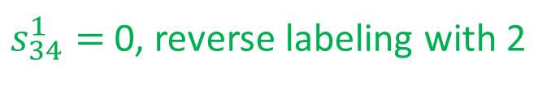
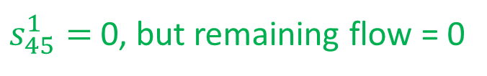
Question 3
$s_{13}^{1}=$ -1
$s_{34}^{1}=$ 0, reverse labeling with 2
$s_{12}^{1}=$0
(10,1)
$s_{25}^{1}=$ -2
2
$s_{14}^{1}=$0
$s_{45}^{1}=$0, but remaining flow = 0
(6,2,2,0)
7
(∞,0)
(7,2,10,0)
1
5
(8,3,2,2)
(2,1)
(7,4,0,5)
0
4
15
(6,2,0,3)
(2,4)
(3,1,4,3)
3
8
Legend: (u_{ij},l_{ij},r_{ij},f_{ij})
5

Slide 20





Question 3
$s_{25}^{1}=$ -2
$$\min\left(2,6,3\right)=2$$
$s_{25}^{2}=$ -6
$s_{45}^{1}=$ 0: disregard
(10,1)
$s_{45}^{2}=$-3
2
(6,2,2,0)
7
(∞,0)
(7,2,10,0)
1
5
(8,3,2,2)
(2,1)
(7,4,0,5)
0
4
15
(6,2,0,3)
(2,4)
(3,1,4,3)
13
3
8
Legend: (u_{ij},l_{ij},r_{ij},f_{ij})
5

Slide 21
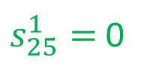
Question 3
$s_{13}^{1}=$-1
Breakthrough of 2
$s_{12}^{1}=$ 0
(10,1)
$s_{25}^{1}=$ 0
2
(6,2,2,0)
7
(∞,0)
(7,2,10,0)
(2,2)
1
5
(8,3,2,2)
(7,4,0,5)
0
4
13
(6,2,0,3)
(3,1,4,3)
3
8
Legend: (u_{ij},l_{ij},r_{ij},f_{ij})
5

Slide 22
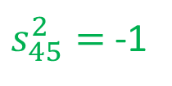

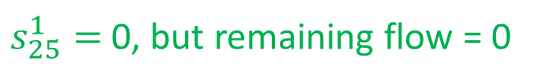
Question 3
$s_{13}^{1}=$-1
$s_{45}^{2}=$-1
$s_{12}^{1}=$ 0
(8,1)
$s_{34}^{1}=$0, reverse labeling with 2
$s_{25}^{1}=$ 0, but remaining flow = 0
2
Non-breakthrough
$s_{14}^{1}=$0
$s_{45}^{1}=$0, but remaining flow = 0
(6,2,0,2)
7
(∞,0)
(7,2,8,2)
1
5
(8,3,2,2)
(2,1)
(7,4,0,5)
0
4
13
(6,2,0,3)
(2,4)
(3,1,4,3)
3
8
Legend: (u_{ij},l_{ij},r_{ij},f_{ij})
5

Slide 23





Question 3
$s_{25}^{1}=$ 0: disregard
$$\min\left(4,1\right)=1$$
$s_{25}^{2}=$ -4
$s_{45}^{1}=$ 2: disregard
(8,1)
$s_{45}^{2}=$-1
2
(6,2,0,2)
7
(∞,0)
(7,2,8,2)
1
5
(8,3,2,2)
(2,1)
(7,4,0,5)
0
4
13
(6,2,0,3)
(2,4)
(3,1,4,3)
12
3
8
Legend: (u_{ij},l_{ij},r_{ij},f_{ij})
5

Slide 24
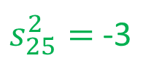
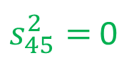
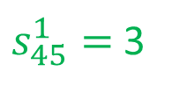
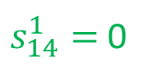
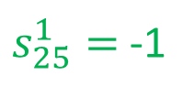
Question 3
$s_{13}^{1}=$-1
$s_{45}^{1}=$3
$s_{12}^{1}=$ 0
$s_{45}^{2}=$0
(8,1)
$s_{25}^{1}=$ -1
2
Breakthrough of 2
$s_{25}^{2}=$ -3
$s_{14}^{1}=$0
(6,2,0,2)
7
(∞,0)
(7,2,8,2)
(2,4)
1
5
(8,3,2,2)
(2,1)
(7,4,0,5)
0
4
12
(6,2,0,3)
(3,1,4,3)
3
8
Legend: (u_{ij},l_{ij},r_{ij},f_{ij})
5

Slide 25
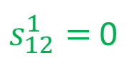
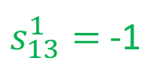
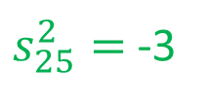
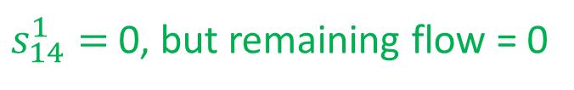
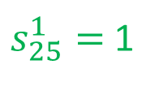
Question 3
$s_{13}^{1}=$-1
$s_{12}^{1}=$ 0
(8,1)
$s_{25}^{1}=$ 1
2
$s_{25}^{2}=$ -3
$s_{14}^{1}=$0, but remaining flow = 0
(6,2,0,2)
7
(∞,0)
(7,2,8,2)
1
5
(8,3,0,4)
(7,4,0,5)
0
4
12
(6,2,0,3)
(3,1,4,3)
(7,4,∞,2)
3
8
Legend: (u_{ij},l_{ij},r_{ij},f_{ij})
5

Slide 26







Question 3
$s_{13}^{1}=$ 1: disregard
$$\min{(3,5,3)}=3$$
$s_{13}^{2}=$ -3
$s_{14}^{1}=$ 0: disregard
(8,1)
$s_{14}^{2}=$-5
2
$s_{25}^{1}=$1: disregard
(6,2,0,2)
$s_{25}^{2}=$-3
7
(∞,0)
(7,2,8,2)
1
5
(8,3,0,4)
(7,4,0,5)
0
4
12
(6,2,0,3)
(3,1,4,3)
9
(7,4,∞,2)
3
8
5
Legend: (u_{ij},l_{ij},r_{ij},f_{ij})
5
2

Slide 27
Question 3
Optimal durations
Increase in cost = 1 * 3 + 2 * 5 + 1 * 7 + 2 * 9 = 38
Or act. 1-3: 3 * 3 = 9, act. 1-4: 2 * 4 = 8, act. 2-5: 3 * 2 = 6, and
act. 4-5: 3 * 5 = 15: total = 9 + 8 + 6 + 15 = 38
2
(6,2,2)
7
7
3
(7,2,10)
1
5
(8,3,4)
(7,4,5)
6
4
0
3
4
10
(6,2,3)
(3,1,7)
3
3
6
Legend: (u_{ij},l_{ij},a_{ij})
3

